Slide 1
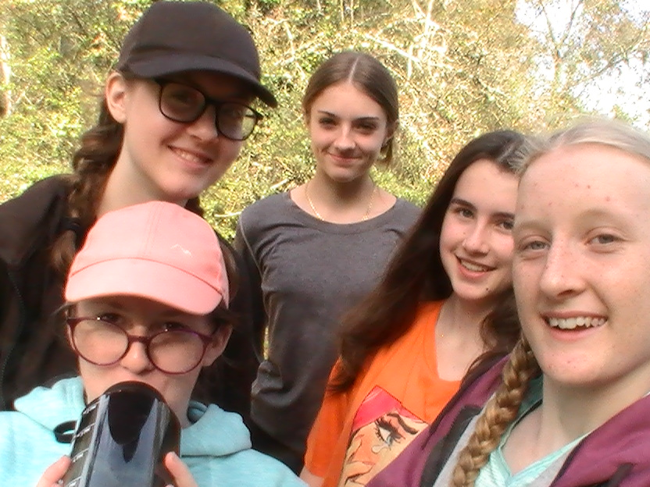
Bronze Expedition day 1
Ellowyn Tones
Emily Overy
Hannah Haynes
Lily Kingsley
Naomi Burnish
Notes:
Bronze Expedition day 1
Ellowyn Tones
Emily Overy
Hannah Haynes
Lily Kingsley
Naomi Burnish
After many months of training, practice expeditions, cooking and setting up tents, we are ready for our qualifying expedition. Our group aim was to explore sites in the new forest connected to WW1 & WW2 to increase our awareness and understanding of the impact of these events on local areas and communities

Slide 2
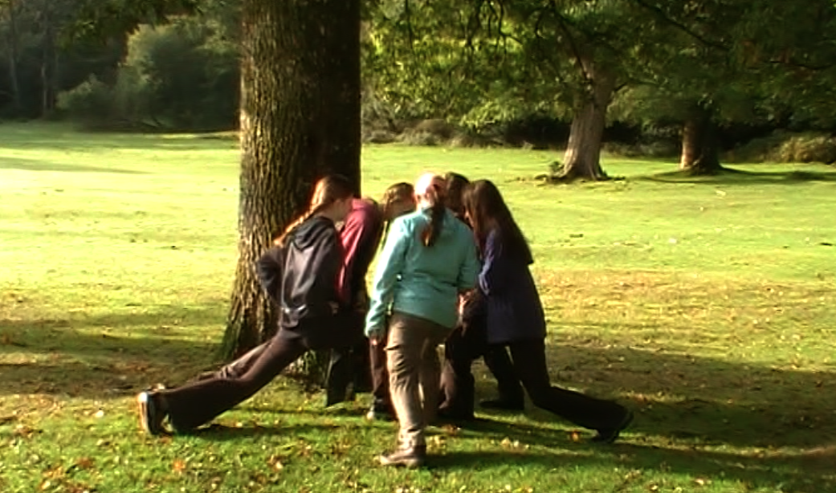
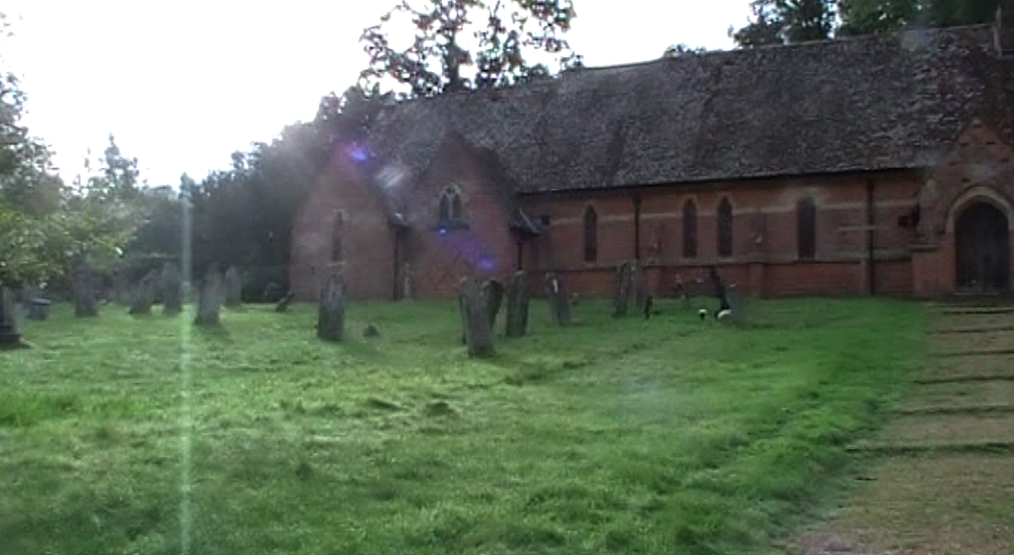
At the start of the day 1.
Notes:
We started of at Swan Green, Emery Down making sure to adjust our bags and to have a drink to stay hydrated. We also made sure to warm up our muscles to make sure we don’t injure ourselves while waking. After that we started to head off to Emery Down Church.

Slide 3
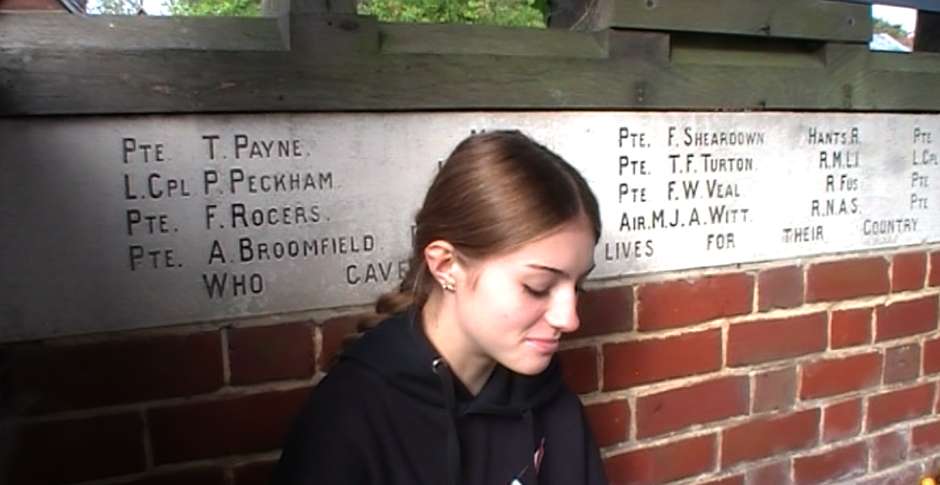
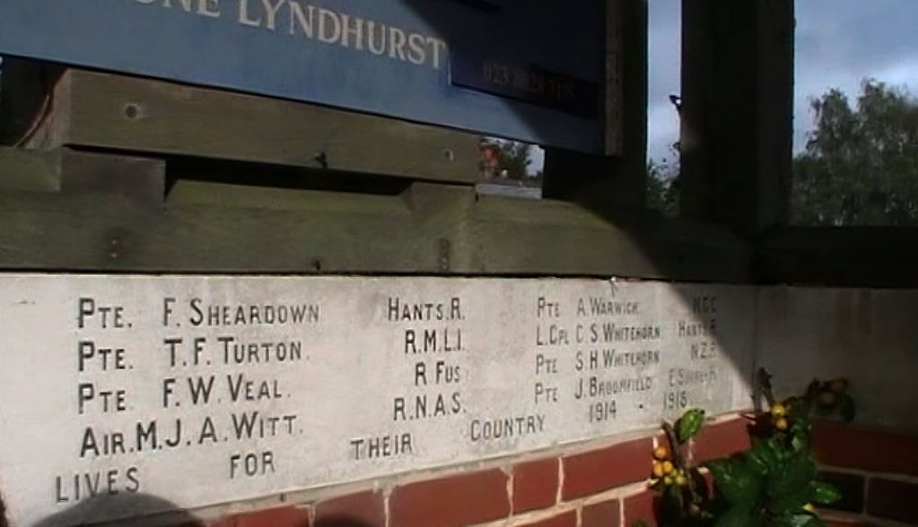
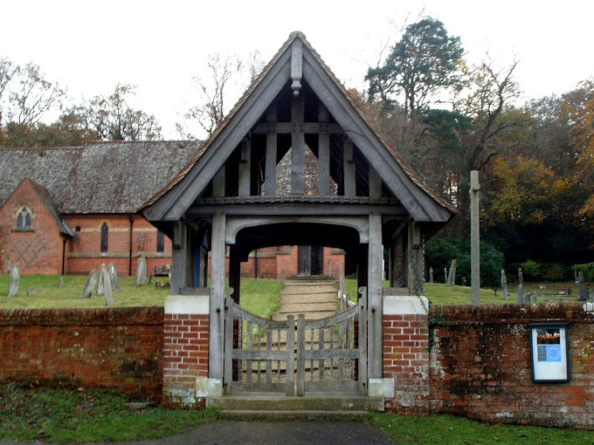
Notes:
Here we found the memorial to all the soldiers who died during the wars that had lived in Emery Down. It was unusually created in the form of a Lychgate Initially the vicar and churchwardens had decided not to have a war memorial in the ecclesiastical parish of Christ Church, Emery Down and that the names of those who had died in the Great War should be inscribed on the proposed war memorial for the civil parish of Lyndhurst. Local opinion must have swayed this decision as by December 1919 subscriptions had begun to be received. There are 22 names inscribed in memory of those who fell in The Great War and a further 4 were added later from World war 2
After stopping there we headed down to the new forest heritage centre in Lyndhurst

Slide 4
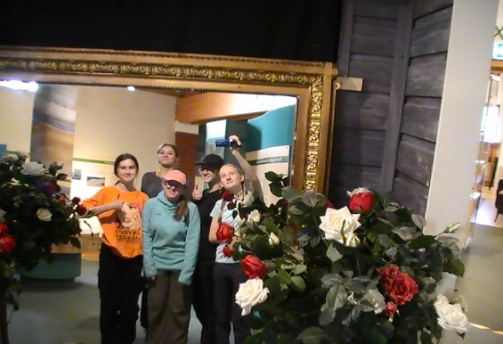
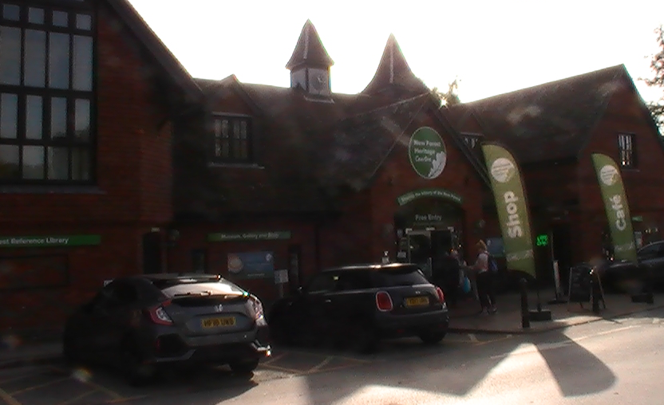
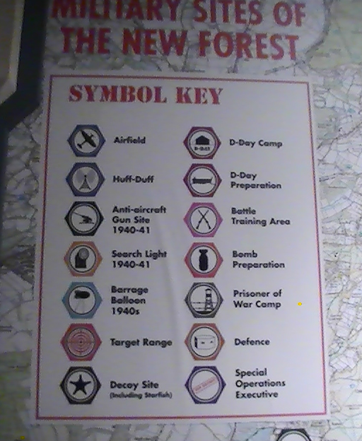
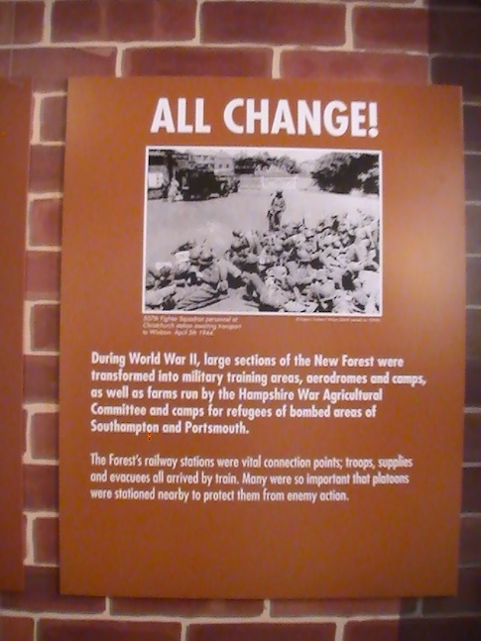
New Forest Heritage Centre, Lyndhurst
Notes:
This is the entrance to New Forest Heritage Centre. In here we found lots of information and details about how the new forest helped out with the war effort, including a interactive map showing the many air fields, encampments and search lights sited here.

Slide 5
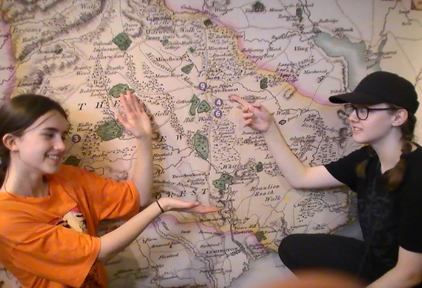
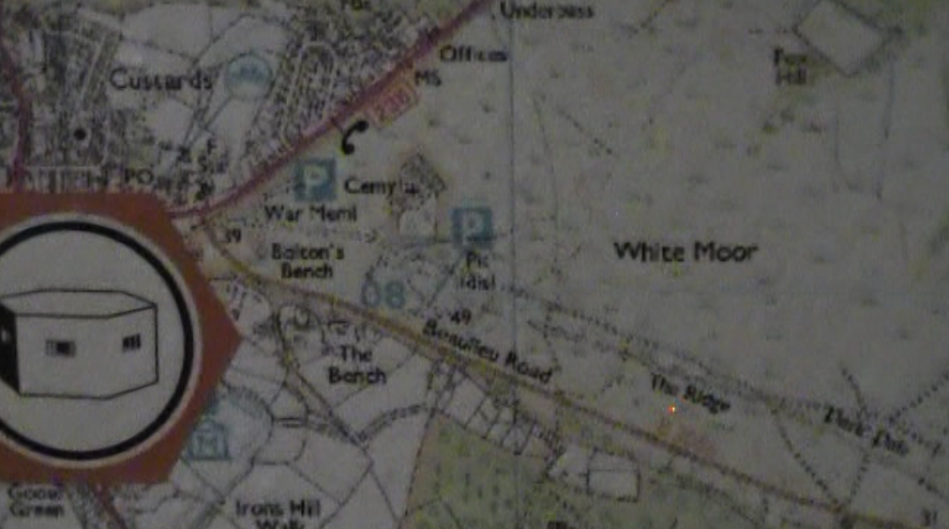
Notes:
This is part of that map and we could trace out some of the route we would be taking later that day from Boltons Bench and along the Ridge towards Ferny Crofts. Is shows the location of look out posts know as “pill Boxes” because of their shape.

Slide 6
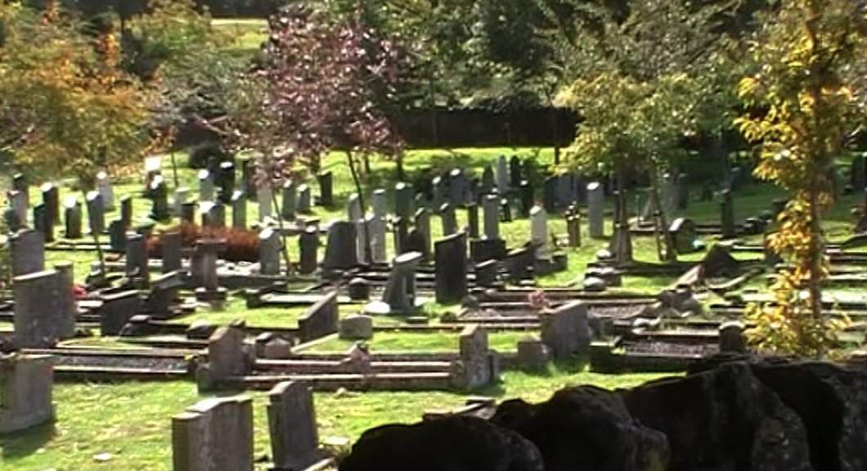
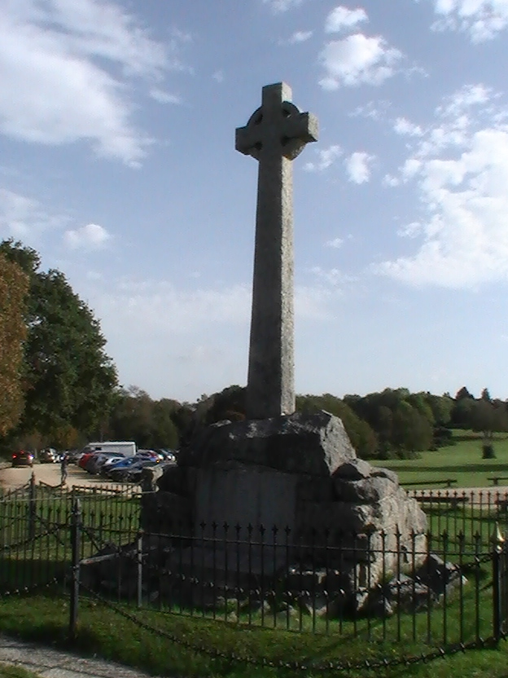
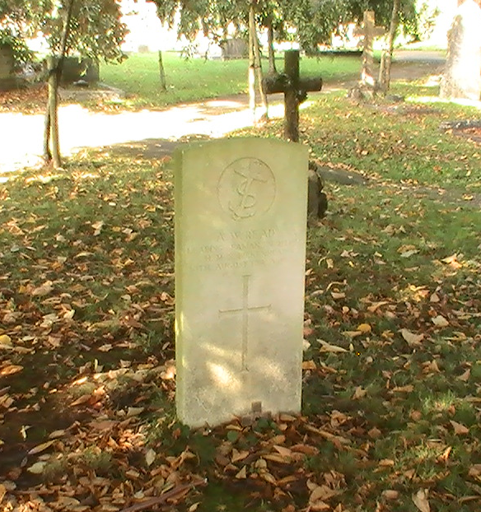
Lyndhurst War Memorial
Notes:
Next we headed off to the Lyndhurst war memorial and also went to the Lyndhurst grave yard where we found some of the graves of soldiers who fought in world war 1, as well as all the names of those from the parish who fort and died in ww1, WW2 and the Falklands

Slide 7
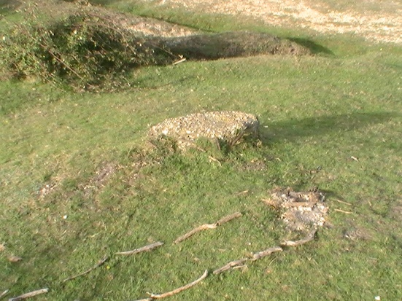
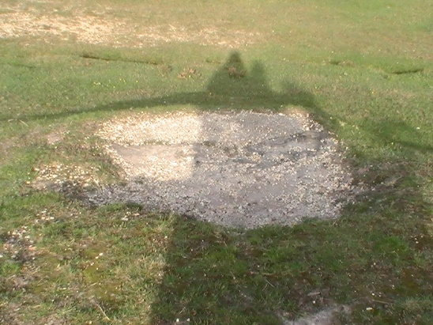
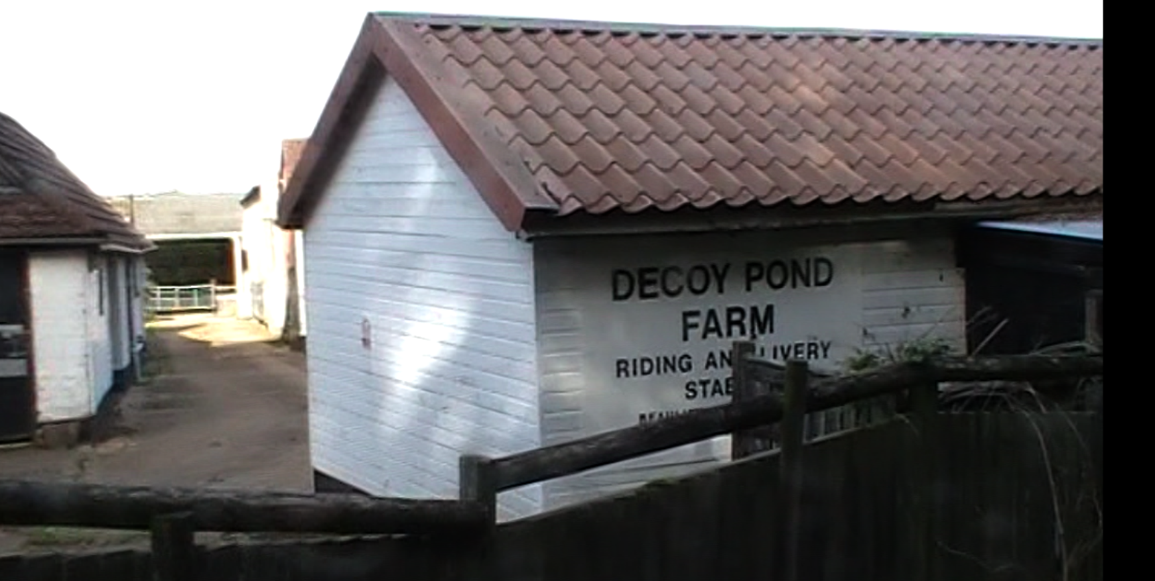
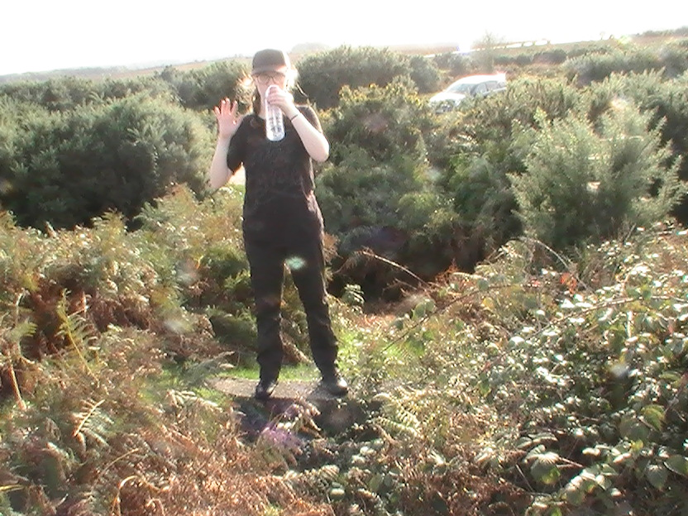
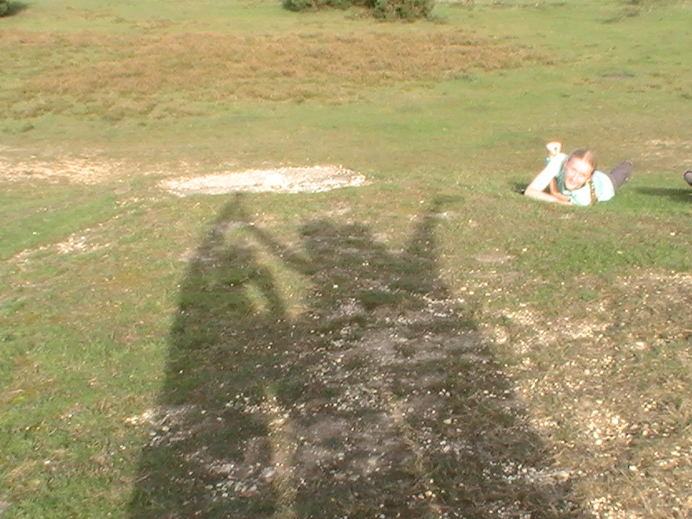
Decoy pond farm & Yew tree heath carpark
Evidence of former building at Yew tree heath car park
Decoy pond was farm was named after a near by starfish decoy.
Notes:
Decoy pond was farm was named after a near by starfish decoy. Starfish decoy are strategically placed lights and building to replicate a burning city and pull the bombers away from Southampton.
Yew tree heath was part of the starfish decoy site and was an old search tower. This is where we ended the day and got our final evidence for this day

Slide 8
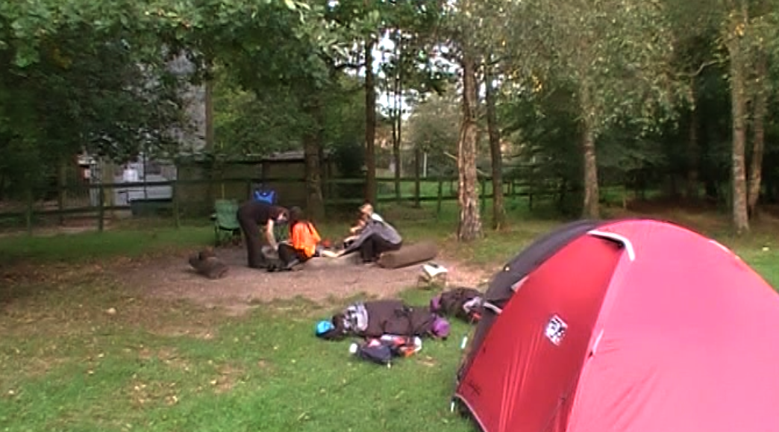
End of day 1. Ferny Crofts
Notes:
We arrived at ferny crofts scout camp. We were very efficient with setting up our tents and using our time very effectively. In the team of 3, two of them set up and the other started setting up ready for cooking our evening meal. In the team of 2 they set up there tent slightly quicker and then straight away started cooking. We enjoyed a camp fire later in the evening.

Slide 9
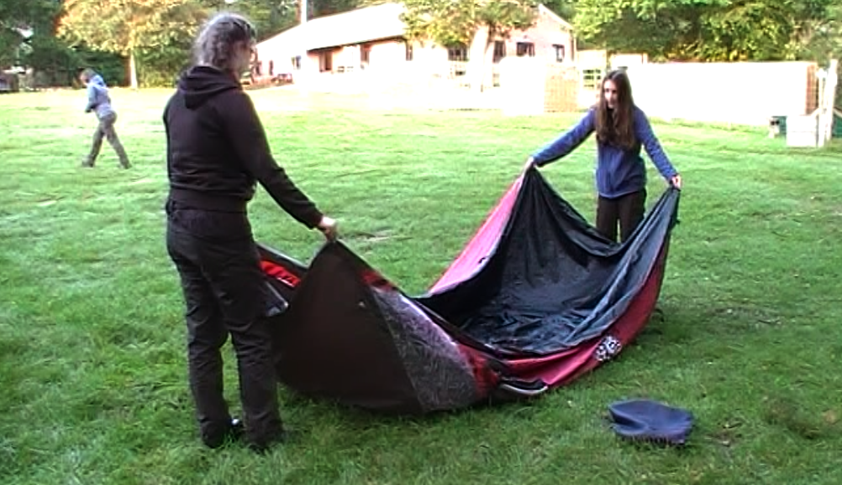
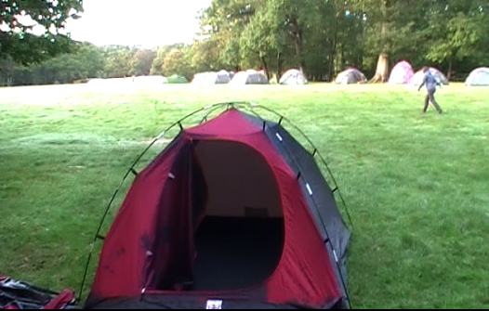
Morning day 2
Notes:
We started the day with breakfast, put the tents down, packed the bags with all the stuff we had.
The progress between the two teams was very close with Emily and Hannah on one team and Naomi packing the tent for the team while Lily and Ellowyn washed up the breakfast items. We then set off about 10 minutes later than expected.

Slide 10
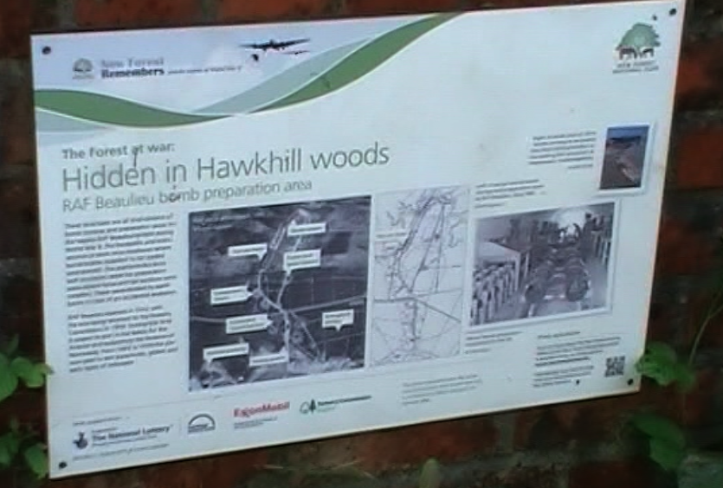
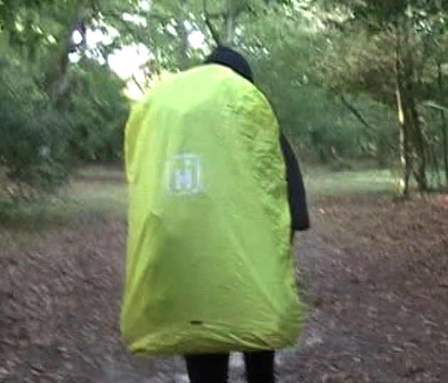
And we are off.
Notes:
We headed to Pig Bush Car park, with each member f the group taking responsibility for a different aspect. Naomi was leading Lily keeping and eye on the time Ellowyn checking the route.
The walk wasn’t too long and we managed to get to Pig Bush car park in good time. Next we headed to Frame Heath inclosure via Halfpenny Green with the same people leading in till after Hawkhill carpark
This was a longer walk

Slide 11
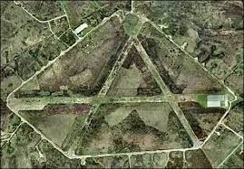
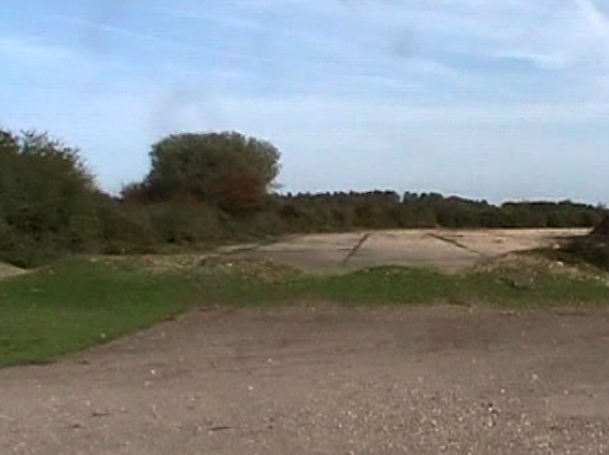
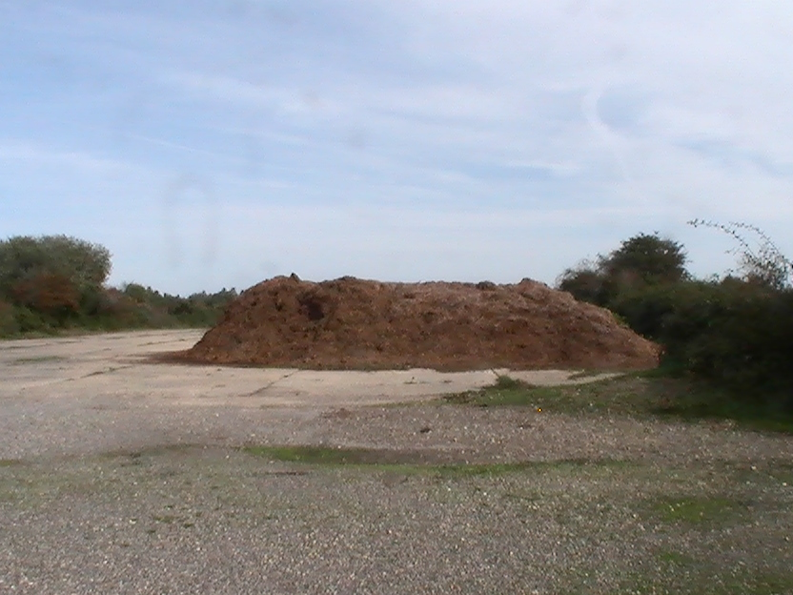
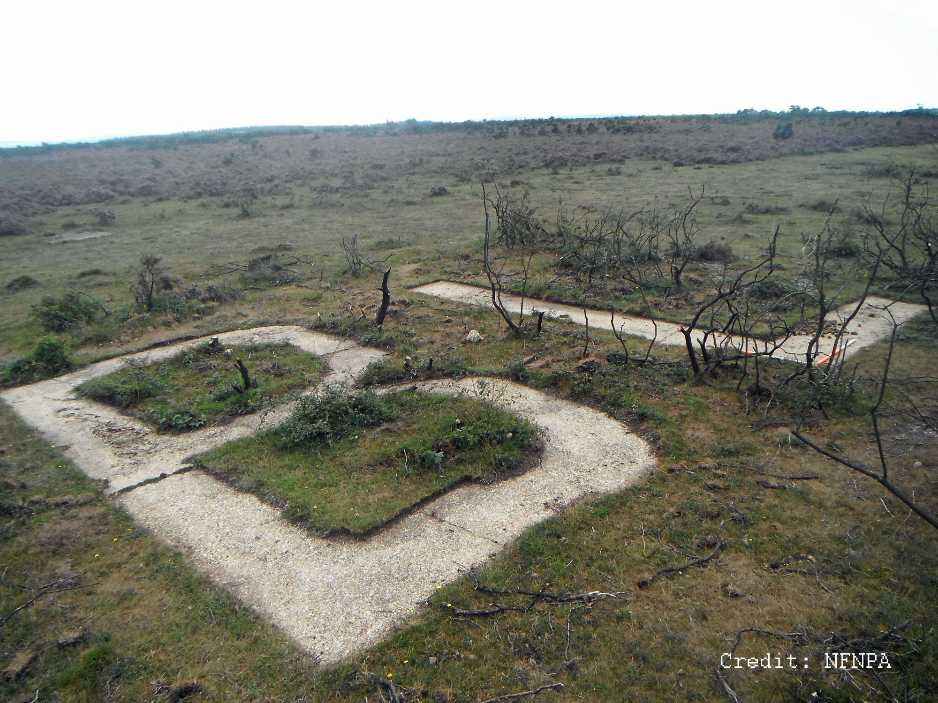
Beaulieu airfield
Airplane runway
Notes:
Royal Air Force Beaulieu or more simply RAF Beaulieu is a former Royal Air Force station in the New Forest, It was also known as Beaulieu airfield, Beaulieu aerodrome and USAAF Station AAF 408. It is located on Hatchet Moor 1 mile (2 km) west of the village of East Boldre,
During the First World War there was a Royal Flying Corps training airfield, RFC Beaulieu, at East Boldre that was closed in 1919
It played an important part in supporting troops in the D Day landings.

Slide 12
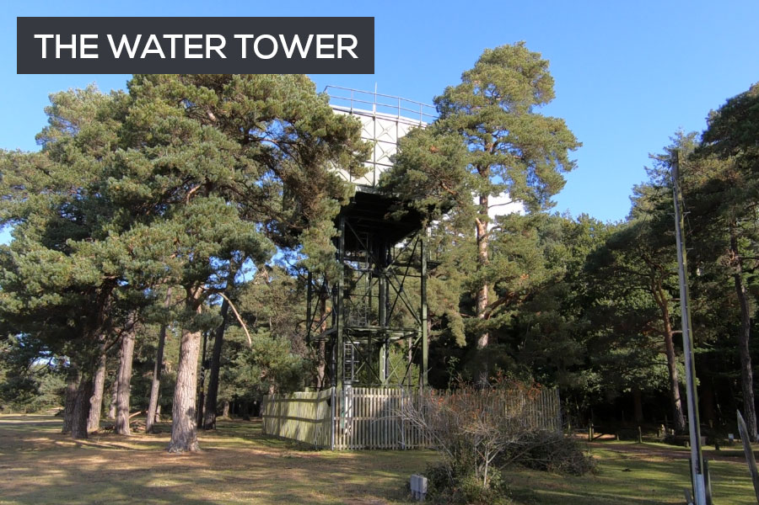
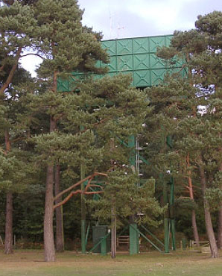
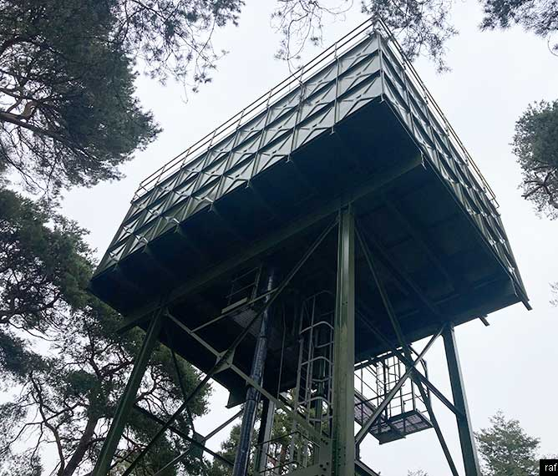
Lunch/tank
Notes:
RAF Beaulieu’s Water Tower on Roundhill Campsite
We stopped for lunch at the old water tank at beaulieu air field and we took photos of the water tank and discussed what it would have been used for back in the day. The water tower still exists today and is about a 10-minute walk north west of the airfield perimeter. It’s located to the right-hand side as you walk into Roundhill campsite.
The water tower is listed as building number 136 on the classified schedule of buildings map from 1945. The map lists it as “water tower 50,000 gallons”, and it would have served the entire 2,000 plus airmen and WAAF women who served there.
If you use the 1945 map of the airfield as a reference, the water tower stands adjacent to Communal Site 1.

Slide 13
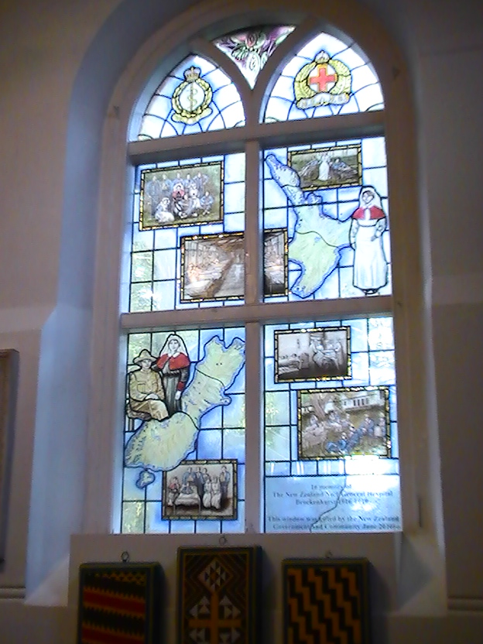
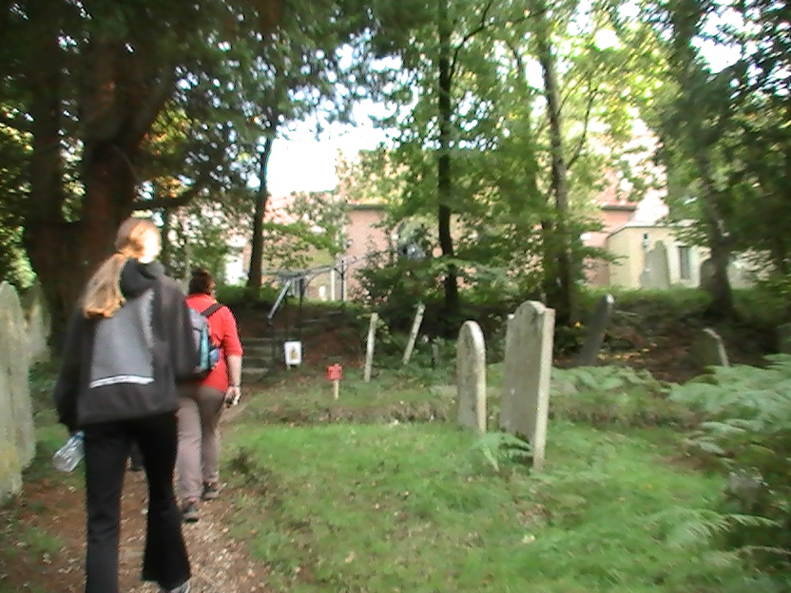
St Nicolas church
Notes:
Our final stop was St Nicolas Church Brockenhurst, A hospital was set up in near by Setley for WW1 casualties and some of the soldiers that sadly died from their injuries there are buried in the grave yard. They were mainly from New Zealand and the graves are looked after by the common wealth war graves commission. There is also a stained glass window commemorating the soldiers and thanking the people of Brockenhust for their support of the wounded soldiers during this time.

Slide 14
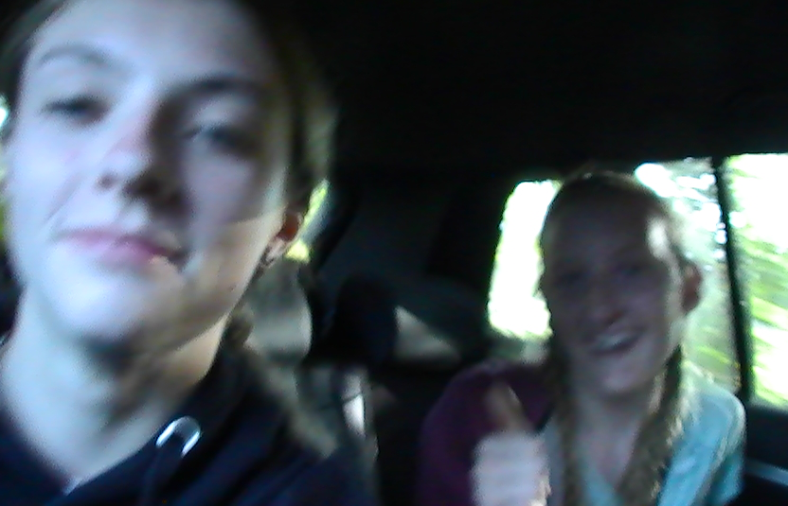
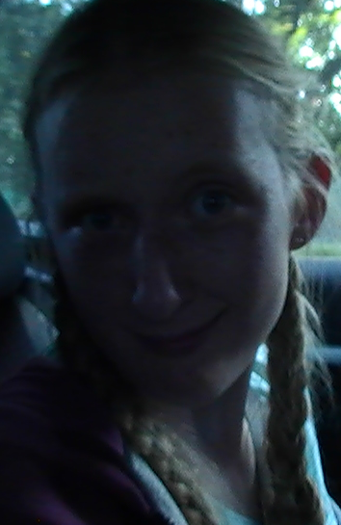
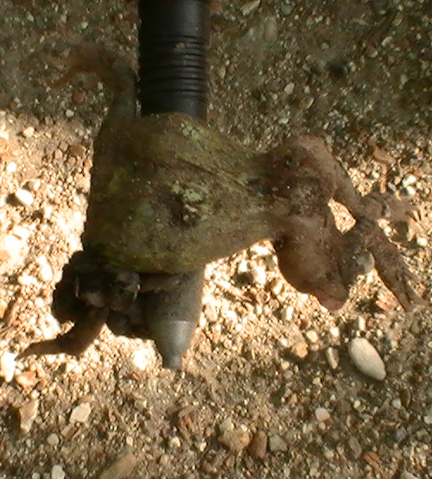
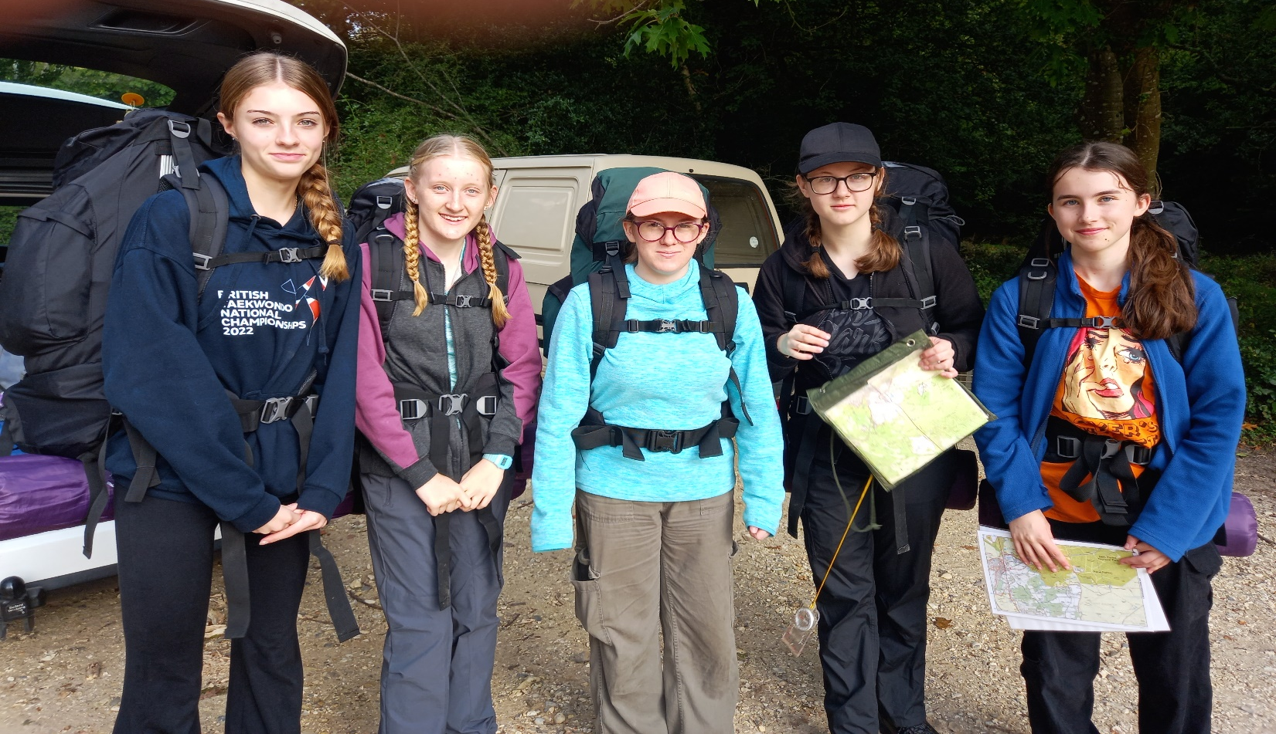
We are home!
Us after:
Notes:
And so we finished- tired, hungry and sore but we did together:

